Slide 1
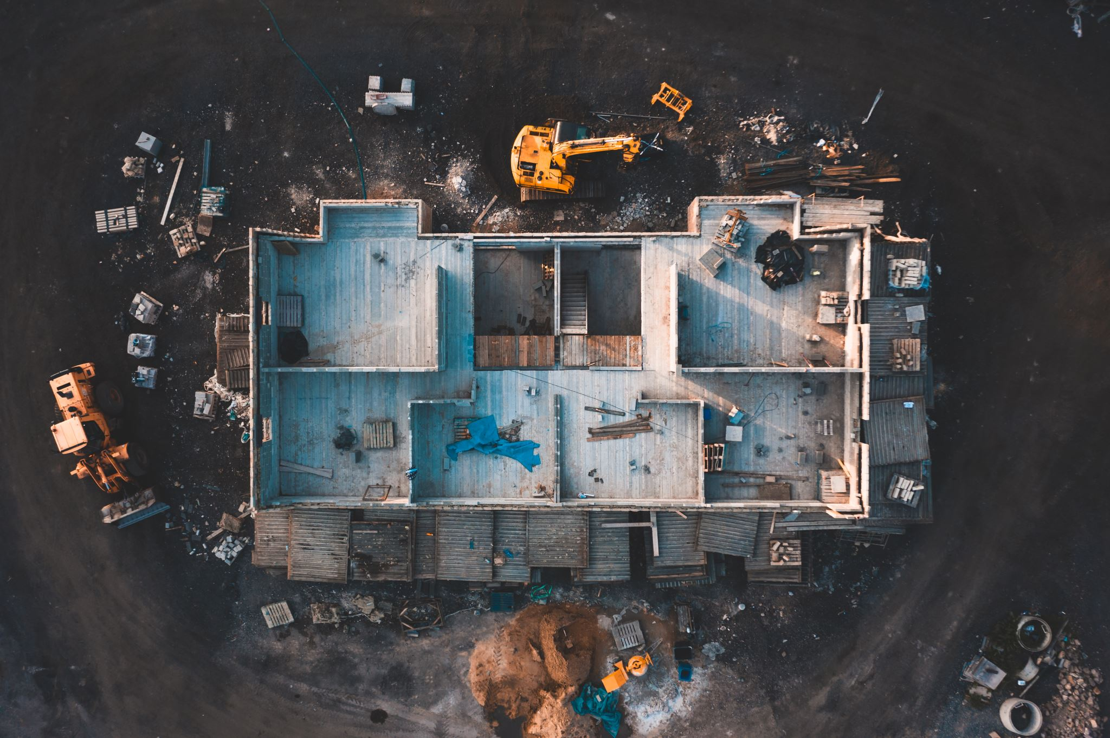
Landfill Documentary and overview.

Slide 2
Landfill is a method of getting rid of very large amounts of rubbish by burying it in a large deep hole.
The environmental costs of landfill. A landfill is a large deep hole in which very large amounts of rubbish are buried.
California state and local government agencies largely oversee or directly manage the cleanup projects disposing the waste out of state. California’s own hazardous waste and the Department of Toxic Substances Control which is one of the biggest out-of-state dumpers and has continued to take its toxic waste.
The (Hazardous Waste Management) Plan will propose strategies for reducing hazardous waste generation, managing more waste in state, and addressing issues of concern, such as hazardous waste impacts to disadvantaged communities,” according to a statement from the department.

Slide 3
Documentary explained that how California handles toxic soil from old industrial, military and other cleanup sites — waste contaminated with things such as lead, petroleum hydrocarbons and the infamous insecticide DDT.
As per report, more than 660,000 tons of toxic soil in Arizona landfills since 2018 and nearly a million tons at a Utah landfill, according to data from the state’s hazardous waste tracking system. That includes more than 105,000 tons from the state’s cleanup of lead-contaminated soil in the neighborhoods around the old Exide battery recycling facility in Los Angeles County.
Overall, I found this documentary extremely interesting and educational, in teaching me that there is a correct and an incorrect way of disposing of our trash. It is very important for the environment.

